Slide 1
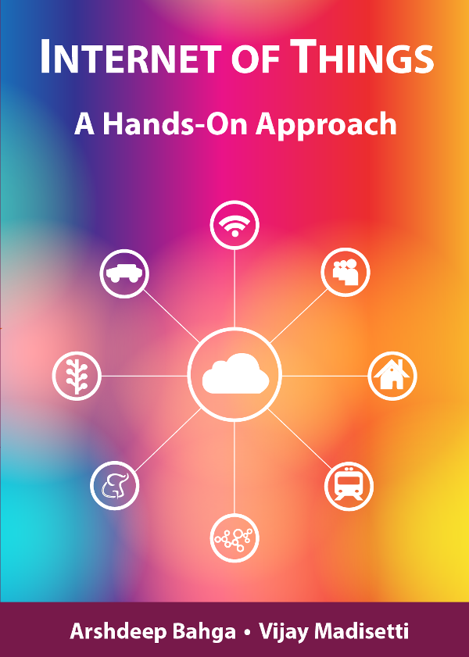
Module 1
Introduction to IoT

Slide 2
Outline
Definition of IoT
Characteristics of IoT
Physical design of IoT
Logical design of IoT
IoT protocols

Slide 3
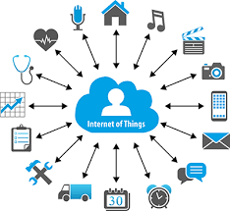
IoT

Slide 4
IoT
Internet Of Things is Fully Networked and Connected Devices sending analytics data back to cloud or data center.
The definition of Internet of things is that it is the network in which every object or thing is provided unique identifier and data is transferred through a network without any verbal communication.
Scope of IoT is not just limited to just connecting things to the internet, but it allows these things to communicate and exchange data, process them as well as control them while executing applications.

Slide 5
Formal Definition of IoT
A dynamic global network infrastructure with self- configuring capabilities based on standard and interoperable communication protocols, where physical and virtual “things” have identities, physical attributes, and use intelligent interfaces, and are seamlessly integrated into information network that communicate data with users and environments.

Slide 6
Characteristics of IoT
Dynamic Global network & Self-Adapting : Adapt the changes w.r.t changing contexts
Self Configuring : Eg. Fetching latest s/w updates without manual intervention.
Interoperable Communication Protocols : Communicate through various protocols
Unique Identity : Such as Unique IP Address or a URI
Integrated into Information Network : This allows to communicate and exchange data with other devices to perform certain analysis.

Slide 7
Physical Design of IoT
Things in IoT
IoT Protocols

Slide 8
Things in IoT
Refers to IoT devices which have unique identities that can perform sensing, actuating and monitoring capabilities.
IoT devices can exchange data with other connected devices or collect data from other devices and process the data either locally or send the data to centralized servers or cloud – based application back-ends for processing the data.

Slide 9
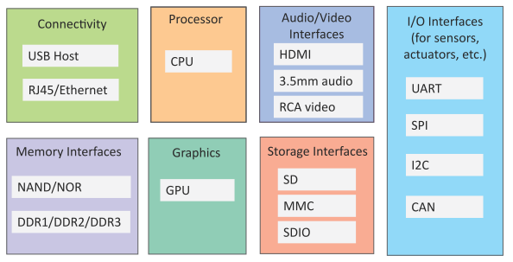
Generic Block Diagram of an IoT Device
An IoT device may consist of several interfaces for connections to other devices, both wired and wireless.
  I/O interfaces for sensors
  Interfaces for internet connectivity
  Memory and storage interfaces
  Audio/video interfaces

Slide 10
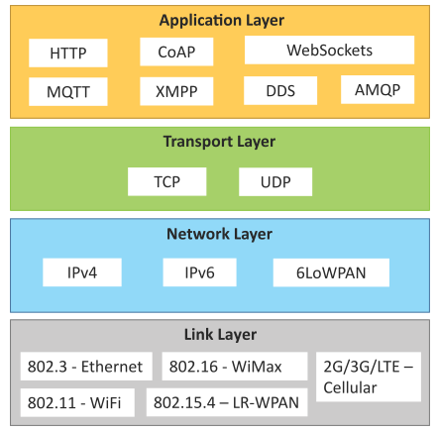
IoT Protocols
Link Layer
  802.3 – Ethernet
  802.11 – WiFi
  802.16 – WiMax
  802.15.4 – LR-WPAN
  2G/3G/4G
Network/Internet Layer
  IPv4
  IPv6
  6LoWPAN
Transport Layer
  TCP
  UDP
Application Layer
  HTTP
  CoAP
  WebSocket
  MQTT
  XMPP
  DDS
  AMQP

Slide 11
IoT Protocols…Link Layer…Ethernet
Sr.No | Standard | Shared medium
1 | 802.3 | Coaxial Cable…10BASE5
2 | 802.3.i | Copper Twisted pair …..10BASE-T
3 | 802.3.j | Fiber Optic……10BASE-F
4 | 802.3.ae | Fiber…..10Gbits/s
Data Rates are provided from 10Gbit/s to 40Gb/s and higher

Slide 12
IoT Protocols…Link Layer…WiFi
Sr.No | Standard | Operates in
1 | 802.11a | 5 GHz band
2 | 802.11b and 802.11g | 2.4GHz band
3 | 802.11.n | 2.4/5 GHz bands
4 | 802.11.ac | 5GHz band
5 | 802.11.ad | 60Hz band
Collection of Wireless LAN
Data Rates from 1Mb/s to 6.75 Gb/s

Slide 13
IoT Protocols…Link Layer…WiMax
Sr.No | Standard | Data Rate
1 | 802.16m | 100Mb/s for mobile stations 1Gb/s for fixed stations
Collection of Wireless Broadband standards
Data Rates from 1.5Mb/s to 1 Gb/s

Slide 14
IoT Protocols…Link Layer…LR-WPAN
Collection of standards for low-rate wireless personal area networks
Basis for high level communication protocols such as Zigbee
Data Rates from 40Kb/s to 250Kb/s
Provide low-cost and low-speed communication for power constrained devices
802.15.4-standard

Slide 15
IoT Protocols…Link Layer…2G/3G/4G –Mobile Communication
Sr.No | Standard | Operates in
1 | 2G | GSM-CDMA
2 | 3G | UMTS and CDMA 2000
3 | 4G | LTE
Data Rates from 9.6Kb/s (for 2G) to up to 100Mb/s (for 4G)

Slide 16
IoT Protocols…Network/Internet Layer
Responsible for sending of IP datagrams from source to destination network
Performs the host addressing and packet routing
Host identification is done using hierarchical IP addressing schemes such as IPV4 or IPV6

Slide 17
IoT Protocols…Network Layer
IPV4
  Used to identify the devices on a network using hierarchical addressing scheme
  Uses 32-bit address scheme
  IPV6
    Uses 128-bit address scheme
    6LoWPAN (IPV6 over Low power Wireless Personal Area Network)
      Used for devices with limited processing capacity
      Operates in 2.4 Ghz
      Data Rates of 250Kb/s

Slide 18
IoT Protocols…Network Layer
IP Routing on Subnets
Basic Subnet Masks
Class | Subnet Mask
A | 255.0.0.0
B | 255.255.0.0
C | 255.255.255.0

Slide 19
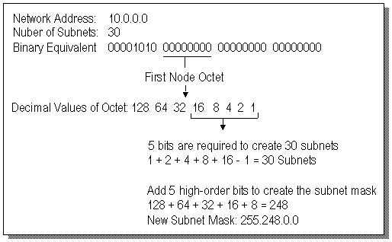
IoT Protocols…Network Layer
Subnetting IP Addresses
Creating Subnets on a Class A Network

Slide 20
IoT Protocols…Network Layer
Subnetting IP Addresses
Calculating IP Subnet Ranges on Class A Network
Subnet# Start Address End Address
-------------------------------------
1 10.8.0.1 10.15.255.254
2 10.16.0.1 10.23.255.254
3 10.24.0.1 10.3 1.255.254
4 10.32.0.1 10.39.255.254
5 10.40.0.1 10.47.255.254
6 10.48.0.1 10.55.255.254
7 10.56.0.1 10.63.255.254
8 10.64.0.1 10.71.255.254
9 10.72.0.1 10.79.2 55.254
10 10.80.0.1 10.87.255.254

Slide 21
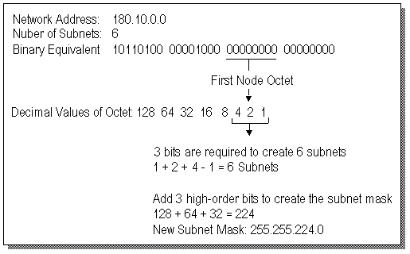
IoT Protocols…Network Layer
Subnetting IP Addresses
Creating Subnets on a Class B Network

Slide 22
IoT Protocols…Network Layer
Subnetting IP Addresses
Calculating IP Subnet Ranges on Class B Network
Subnet# Start Address End Address
--------------------------------------------
1 180.10.32.1 180.10.63.254
2 180.10.64.1 180.10.95.254
3 180.10.96.1 180.10.127.254
4 180.10.128.1 180.10.159.254
5 180.10.160.1 180.10.191.254
6 180.10.192.1 180.10.223.254

Slide 23
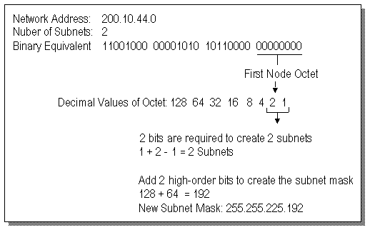
IoT Protocols…Network Layer
Subnetting IP Addresses
Creating Subnets on a Class C Network

Slide 24
IoT Protocols…Network Layer
Subnetting IP Addresses
Calculating IP Subnet Ranges on Class C Network
Subnet# Subnetwork Start End Broadcast
Address Address Address Address
-----------------------------------------------------------------
1 200.10.44.64 200.10.44.65 200.10.44.126 200.10.44.127
2 200.10.44.128 200.10.44.129 200.10.44.190 200.10.44.191

Slide 25
IoT Protocols…Transport Layer
Provide end-to-end message transfer capability independent of the underlying network
It provides functions such as error control, segmentation, flow-control and congestion control

Slide 26
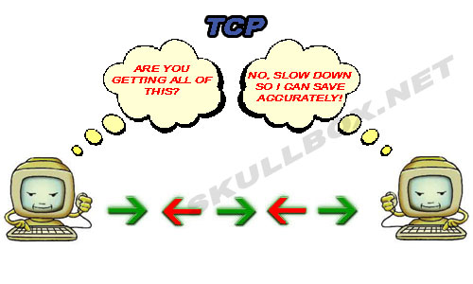
IoT Protocols…TCP
Transmission Control Protocol
Connection Oriented
Ensures Reliable transmission
Provides Error Detection Capability to ensure no duplicacy
of packets and retransmit lost packets
Flow Control capability to ensure the sending data rate is not too high for the receiver process
Congestion control capability helps in avoiding congestion which leads to degradation of n/w performance

Slide 27
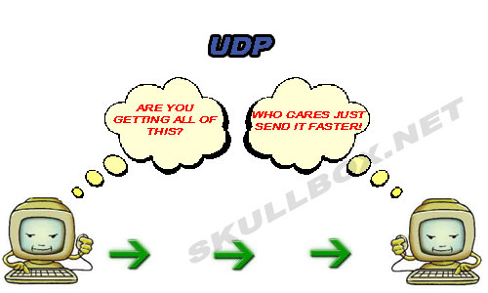
IoT Protocols…UDP
User Datagram Protocol
Connectionless
Does not ensures Reliable transmission
Does not do connection before transmitting
Does not provide proper ordering of messages
Transaction oriented and stateless

Slide 28

IoT Protocols…Application Layer…Hyper Text Transfer Protocol
Forms foundation of World Wide Web(WWW)
Includes commands such as GET,PUT, POST, HEAD, OPTIONS, TRACE..etc
Follows a request-response model
Uses Universal Resource Identifiers(URIs) to identify HTTP resources

Slide 29
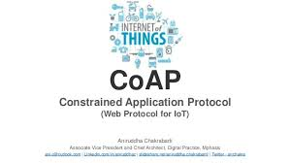
IoT Protocols…Application Layer…CoAP
Constrained Application Protocol
Used for Machine to machine (M2M) applications meant for constrained devices and n/w’s
Web transfer protocol for IoT and uses request-response model
Uses client –server architecture
Supports methods such as GET,POST, PUT and DELETE

Slide 30
IoT Protocols…Application Layer…WebSocket
Allows full-duplex communication over single socket
Based on TCP
Client can be a browser, IoT device or mobile application
IoT Protocols…Application Layer…MQTT
Message Queue Telemetry Transport , light-weight messaging protocol
Based on publish-subscribe model
Well suited for constrained environments where devices have limited processing, low memory and n/w bandwith requirement

Slide 31
IoT Protocols…Application Layer…XMPP
Extensible messaging and presence protocol
For Real time communication and streaming XML data between n/w entities
Used for Applications such as Multi-party chat and voice/video calls.
Decentralized protocol and uses client server architecture.

Slide 32
IoT Protocols…Application Layer…DDS
Data Distribution service is a data-centric middleware standard for device-to-device or machine-to-machine communication.
Publish subscribe model where publishers create topics to which subscribers can use.
Provides Quality-of-service control and configurable reliability.

Slide 33
IoT Protocols…Application Layer…AMQP
Advanced Messaging Queuing Protocol used for business messaging.
Supports both point-to-point and publisher/subscriber models, routing and queuing
Broker here receives messages from publishers and route them over connections to consumers through messaging queues.

Slide 34
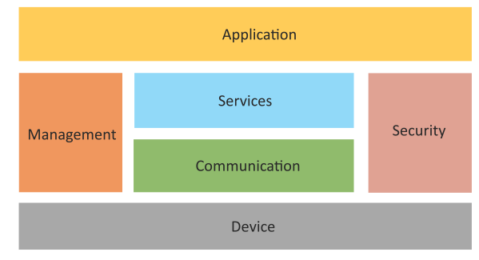
Logical Design of IoT
Logical design of an IoT system refers to an abstract representation of the entities and processes without going into the low-level specifics of the implementation.
An IoT system comprises a number of functional blocks that provide the system the capabilities for identification, sensing, actuation, communication and management.

Slide 35
Logical Design of IoT
Device : Devices such as sensing, actuation, monitoring and control functions.
Communication : IoT Protocols
Services like device monitoring, device control services, data publishing services and device discovery
Management : Functions to govern the system
Security : Functions as authentication, authorization, message and content integrity, and data security
Applications

Slide 36
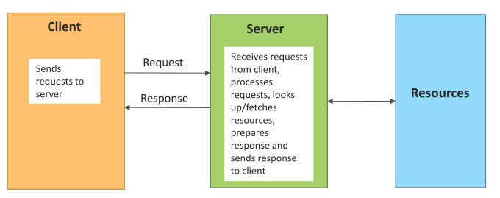
Request–Response Communication Model
Request–Response is a communication model in which the client sends requests to the server and the server responds to the requests.
When the server receives a request, it decides how to respond, fetches the data, retrieves resource representations, prepares the response and then sends the response to the client.
Stateless communication model and each request-response pair is independent of others

Slide 37
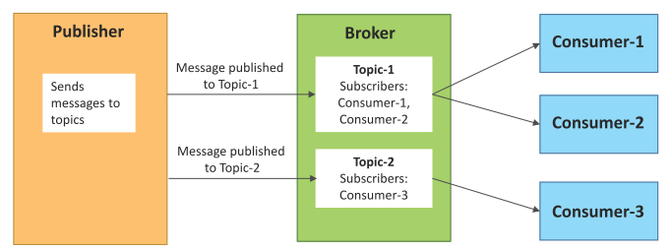
Publish–Subscribe Communication Model
Publish–Subscribe is a communication model that involves publishers, brokers and consumers.
Publishers are the source of data. Publishers send the data to the topics which are managed by the broker. Publishers are not aware of the consumers.
Consumers subscribe to the topics which are managed by the broker.
When the broker receives data for a topic from the publisher, it sends the data to all the subscribed consumers.

Slide 38
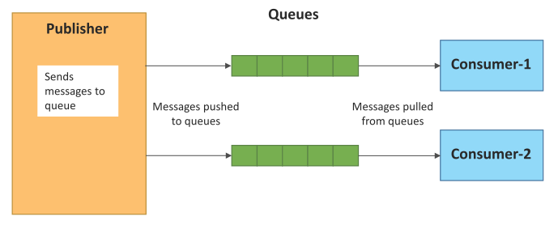
Push–Pull Communication Model
Push–Pull is a communication model in which the data producers push the data to queues and the consumers pull the data from the queues. Producers do not need to be aware of the consumers.
Queues help in decoupling the messaging between the producers and consumers.
Queues also act as a buffer which helps in situations when there is a mismatch between the rate at which the producers push data and the rate at which the consumers pull data.

Slide 39
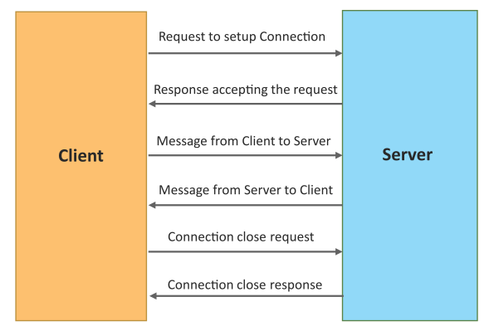
Exclusive Pair Communication Model
Exclusive Pair is a bidirectional, fully duplex communication model that uses a persistent connection between the client and the server.
Once the connection is set up it, remains open until the client sends a request to close the connection.
Client and server can send messages to each other after connection setup.

Slide 40
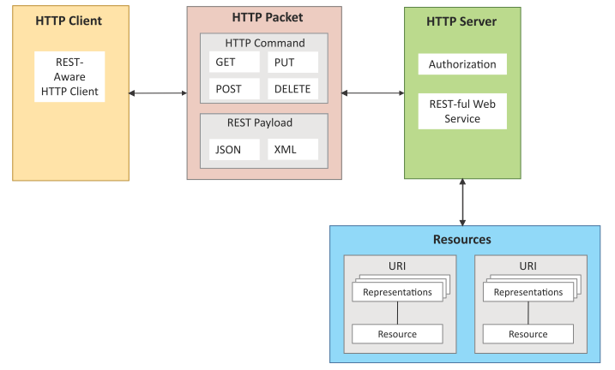
IOT Communication APIs
REST-based Communication APIs
Representational State Transfer (REST) is a set of architectural principles by which you can design web services and web APIs that focus on a system’s resources and how resource states are addressed and transferred.
REST APIs follow the request–response communication model.
REST architectural constraints apply to the components, connectors and data elements within a distributed hypermedia system.

Slide 41
REST-based Communication APIs Constraints
Client – Server
Stateless
Cacheable
Layered System
Uniform Interface
Code on demand
Client
Server
Request
Response
Request
Response

Slide 42
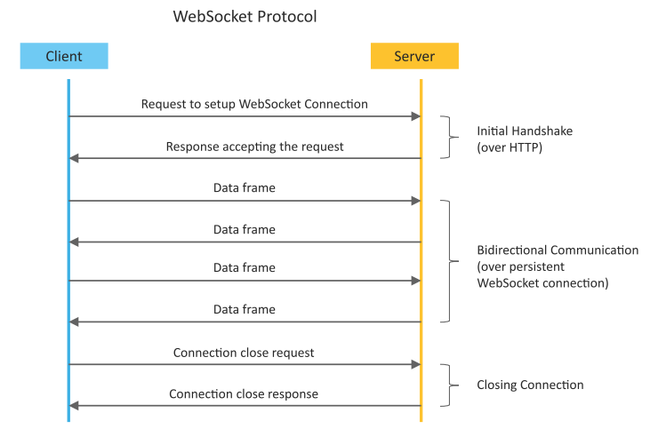
WebSocket-based Communication APIs
WebSocket APIs allow bi-directional, full duplex communication between clients and servers.
WebSocket APIs follow the exclusive pair communication model.

Slide 43
Difference between REST and WebSocket-based Communication APIs
Comparison Based on | REST | Websocket
State | Stateless | Stateful
Directional | Unidirectional | Bidirectional
Req-Res/Full Duplex | Follow Request Response Model | Exclusive Pair Model
TCP Connections | Each HTTP request involves setting up a new TCP Connection | Involves a single TCP Connection for all requests
Header Overhead | Each request carries HTTP Headers, hence not suitable for real-time | Does not involve overhead of headers.
Scalability | Both horizontal and vertical are easier | Only Vertical is easier

Slide 44
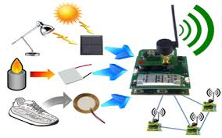

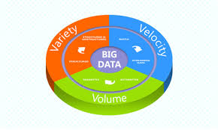
IoT Enabling Technologies
Wireless Sensor Network
Cloud Computing
Big Data Analytics
Embedded Systems

Slide 45
WSN
Distributed Devices with sensors used to monitor the environmental and physical conditions
Consists of several end-nodes acting as routers or coordinators too
Coordinators collects data from all nodes / acts as gateway that connects WSN to internet
Routers route the data packets from end nodes to coordinators.

Slide 46
Example of WSNs in IoT & Protocols used
Example
Weather monitoring system
Indoor Air quality monitoring system
Soil moisture monitoring system
Survelliance systems
Health monitoring systems
Protocols
Zigbee

Slide 47
Wsn ENABLESD BY 802.15.4
Operates at 2.4Ghtz,250KB/s range 10 to 100 mts
WSN is selforganzied

Slide 48
Cloud Computing
Deliver applications and services over internet
Provides computing, networking and storage resources on demand
Cloud computing performs services such as Iaas, Paas and Saas
Iaas : Rent Infrastructure
Paas : supply an on-demand environment for developing, testing, delivering and managing software applications.
Saas : method for delivering software applications over the Internet, on demand and typically on a subscription basis.

Slide 49

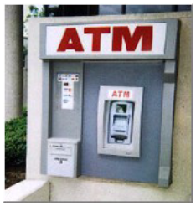
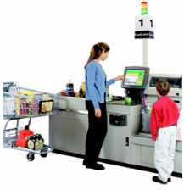
Big Data Analytics
Collection of data whose volume, velocity or variety is too large and difficult to store, manage, process and analyze the data using traditional databases.
It involves data cleansing, processing and visualization
Lots of data is being collected and warehoused
  Web data, e-commerce
  purchases at department/ grocery stores
  Bank/Credit Card transactions
  Social Network

Slide 50
Big Data Analytics
Variety Includes different types of data
Structured
Unstructured
SemiStructured
All of above

Slide 51
Big Data Analytics
Velocity Refers to speed at which data is processed
Batch
Real-time
Streams

Slide 52
Big Data Analytics
Volume refers to the amount of data
Terabyte
Records
Transactions
Files
Tables

Slide 53
Thank You

